Slide 1
Mathematical Foundation of Machine Learning
V. Generative Deep Learning
Notes:
generating new samples by learning distributions.

Slide 2
Outline
Variational Autoencoder (VAE)
Generative Adversarial Network (GAN)
Invertible Density Estimation (Normalizing flow)

Slide 3
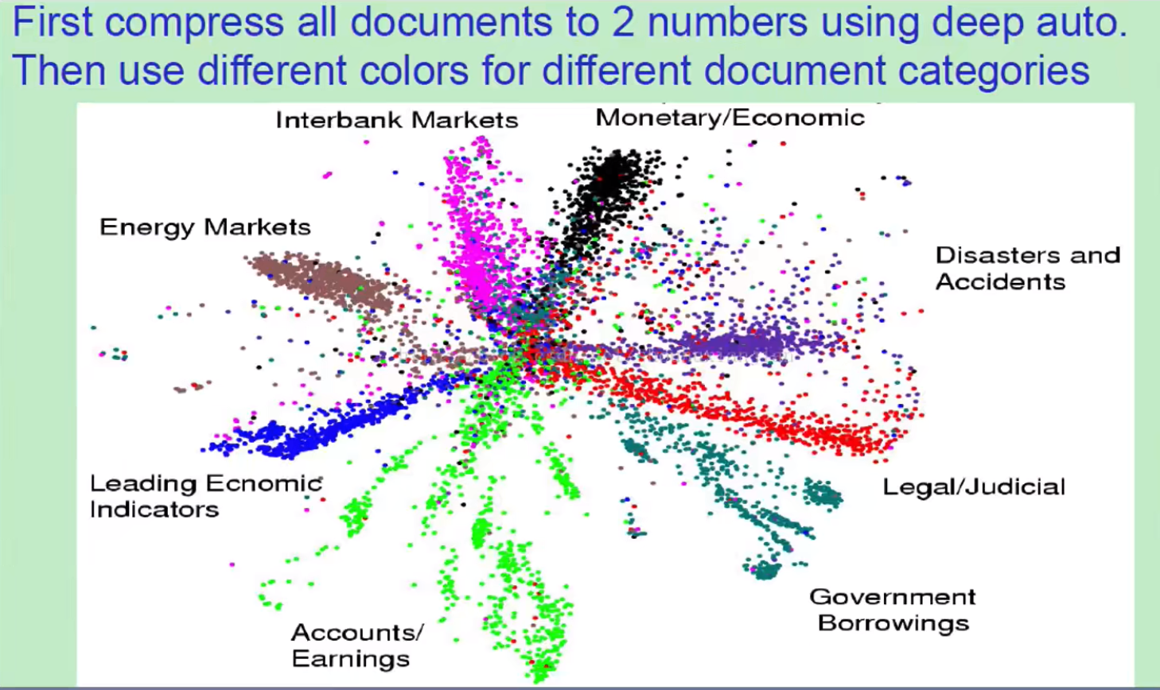
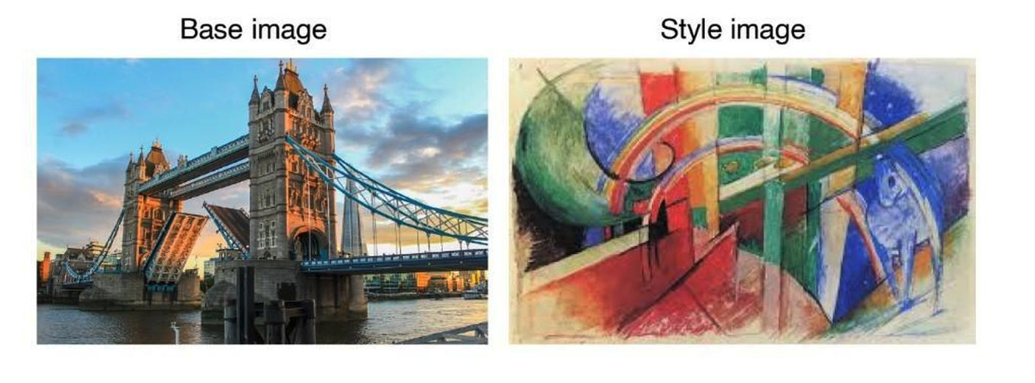
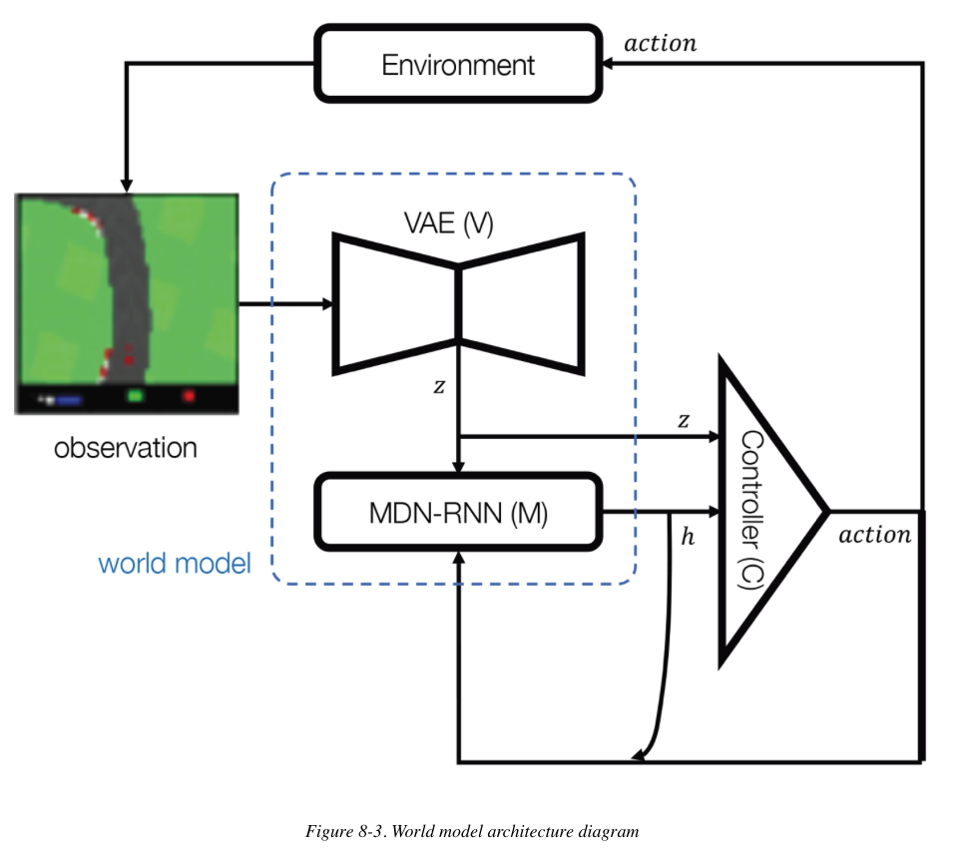
What is generative modeling?
What can generative models do?
density estimation, sample generation, dimension reduction, information retrieval......
Applications: paint, write, compose, play .......
v
Generatie Deep Learning , David Foster

Slide 4
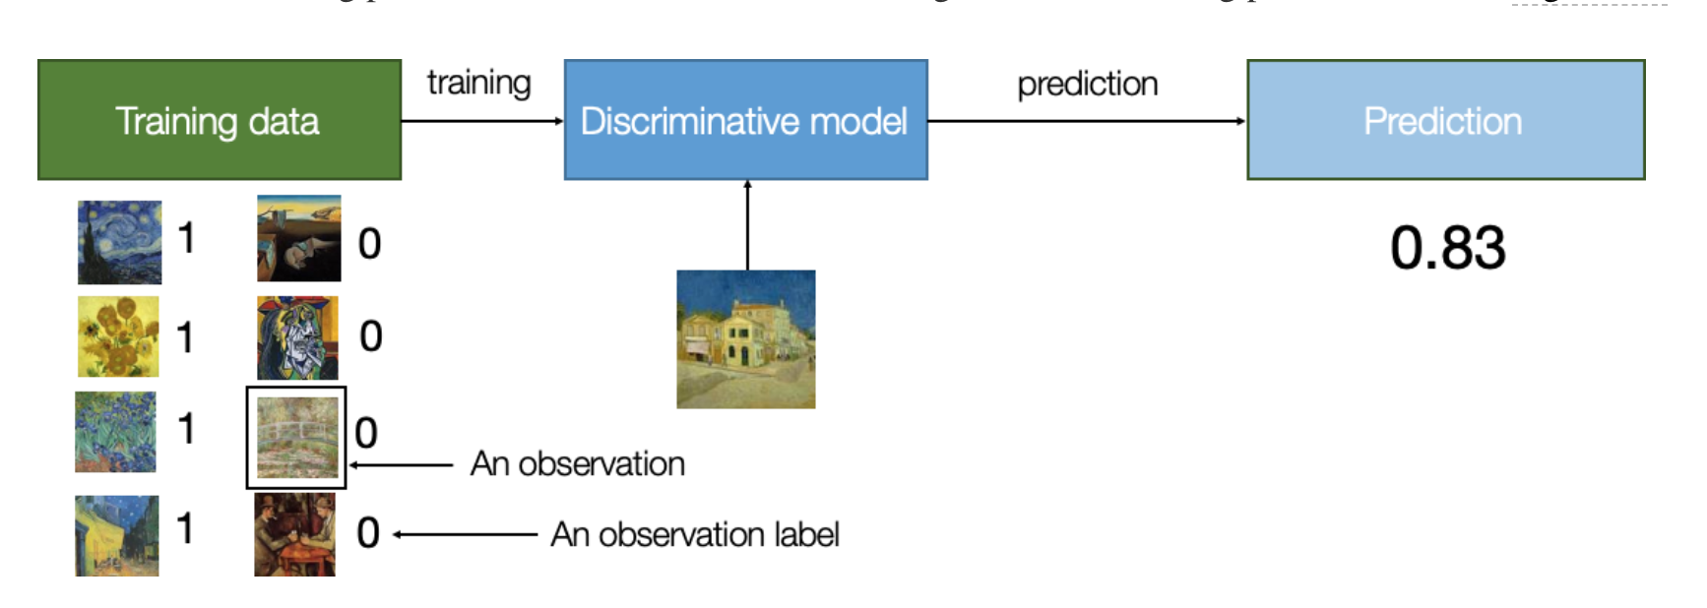
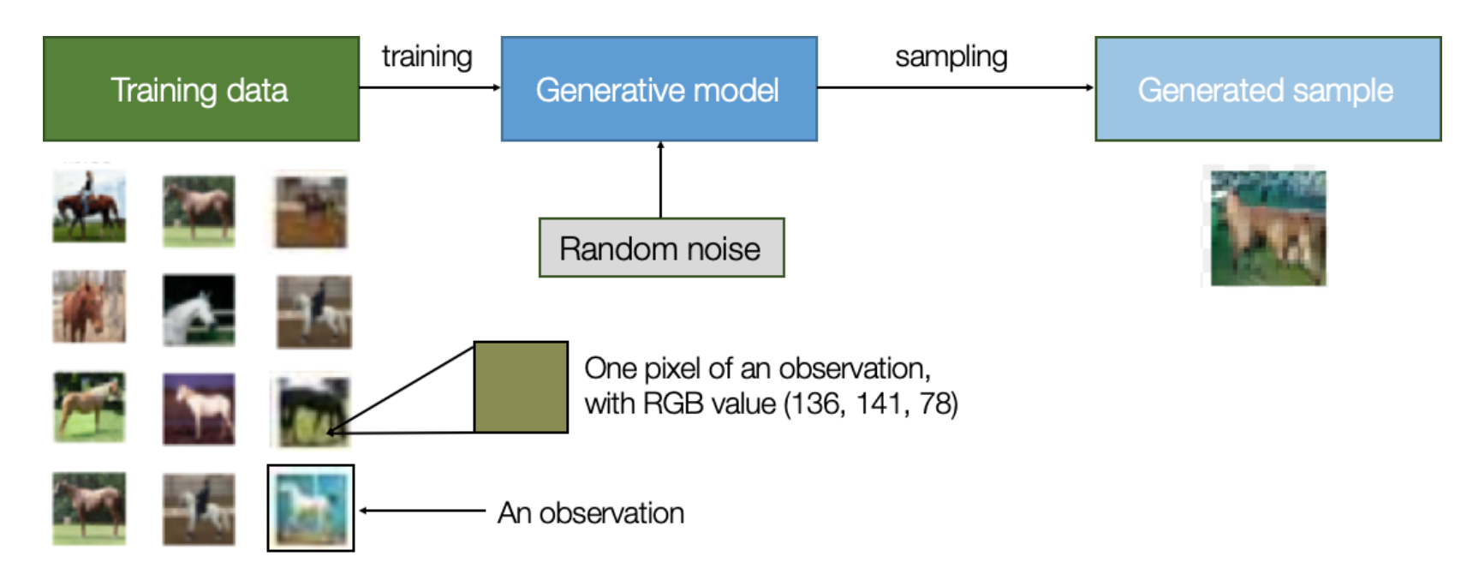
Discriminative model (supervised)
vs.
Generative model
(unsupervised)

Slide 5
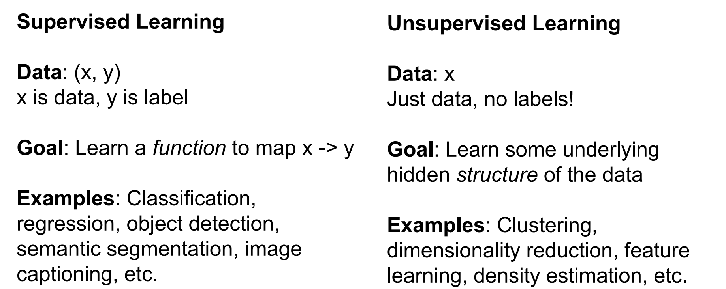

Slide 6
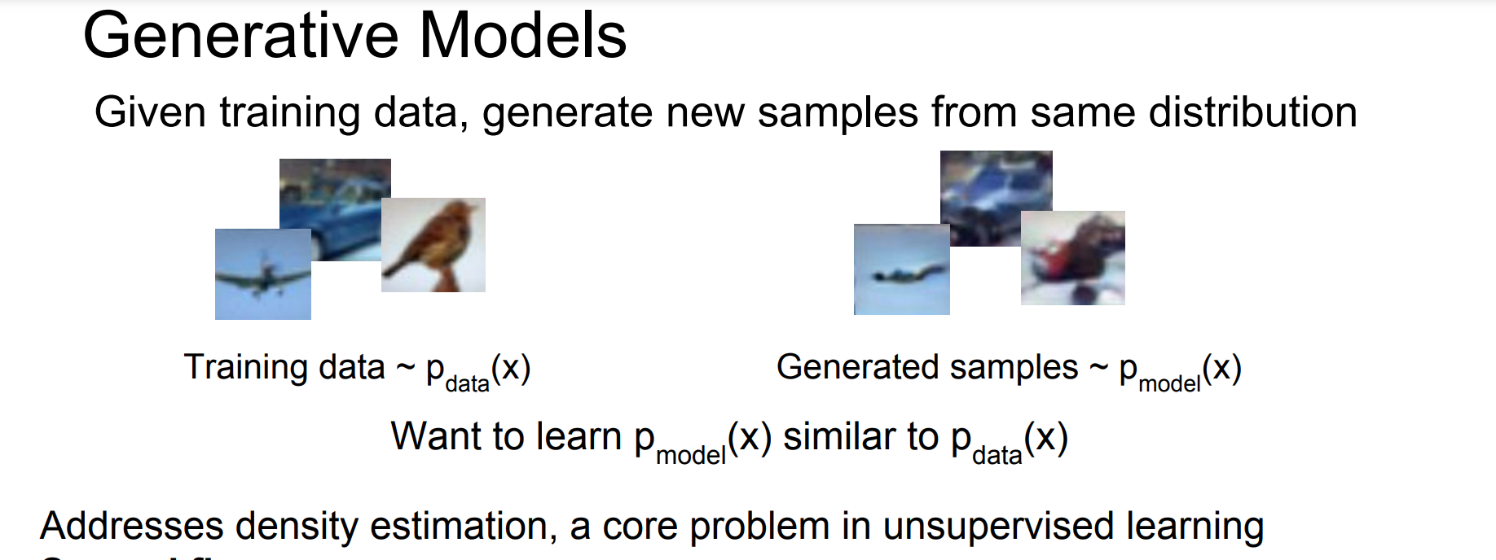
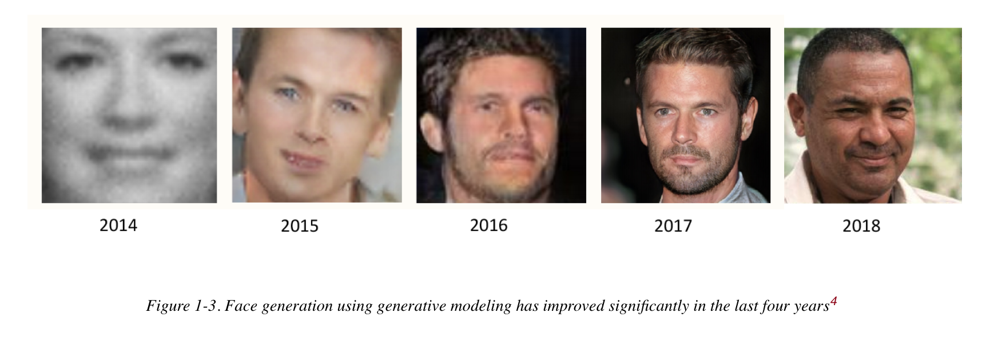
Source: Brundage et al., 2018

Slide 7
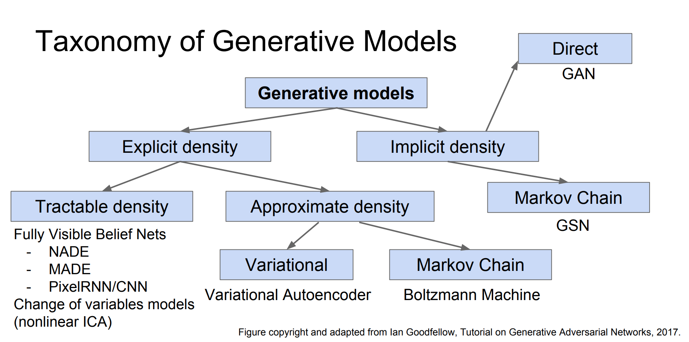

Slide 8
VAE: variational auto-encoder

Slide 9
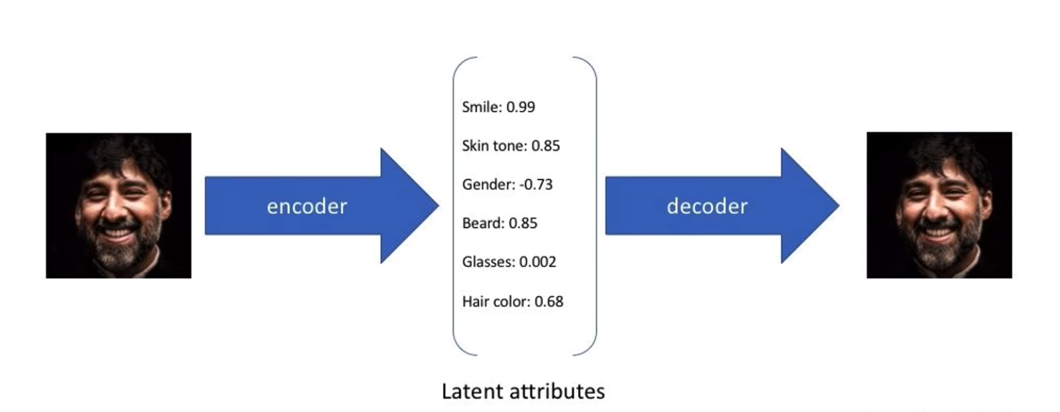
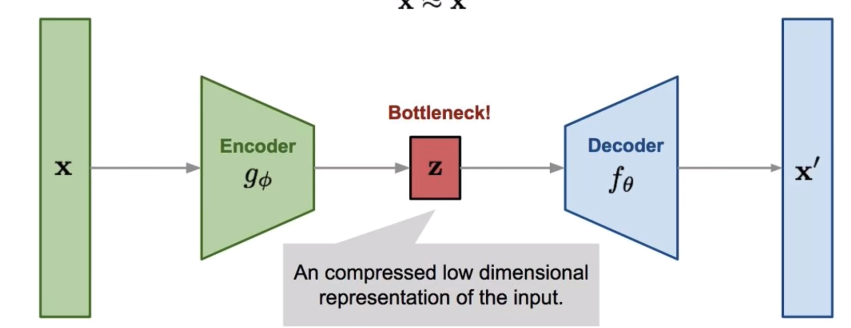
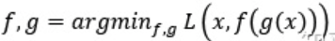
Auto Encoder

Slide 10
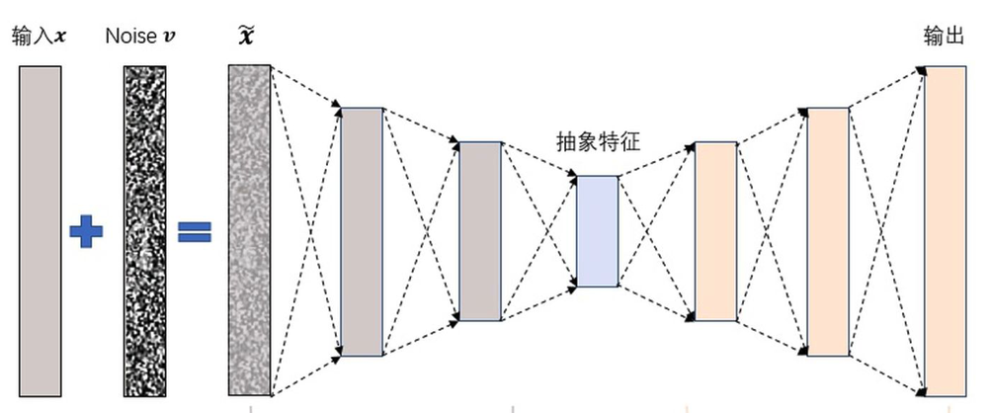
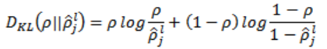
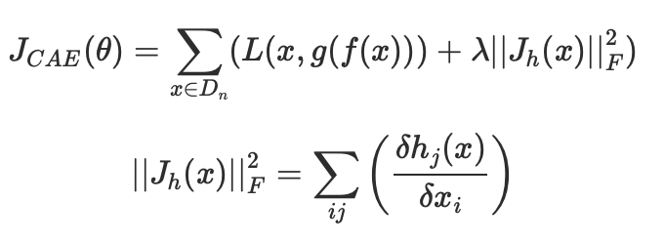
Robustness ?
Denoising AutoEncoder Pascal Vincent etc, 2008
Sparse AutoEncoder Andrew Ng, etc, 2011
Contractive AutoEncoder
Rifai S etc, 2011

Slide 11
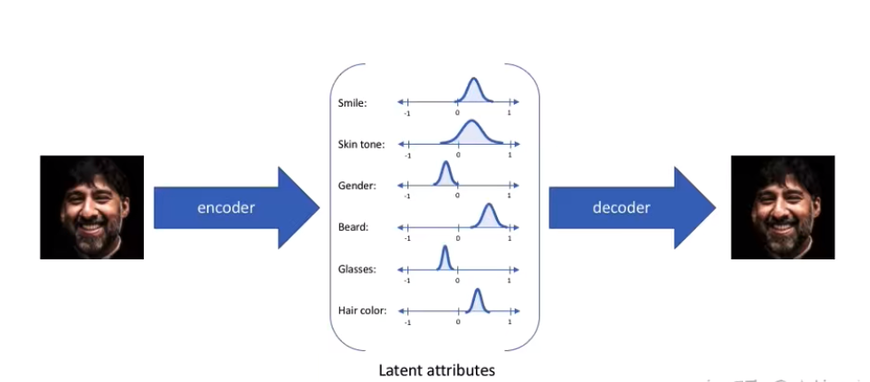
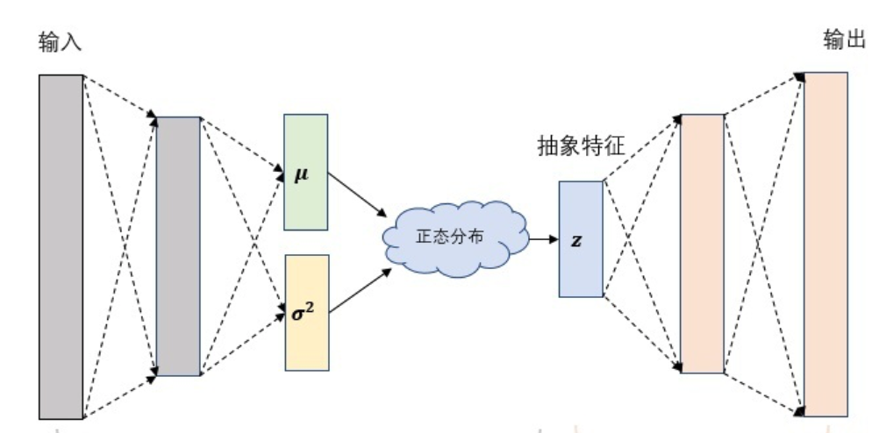
Variational Auto Encoder
Auto-encoding variational bayes, Diederik Kingma etc, ICLR 2014

Slide 12
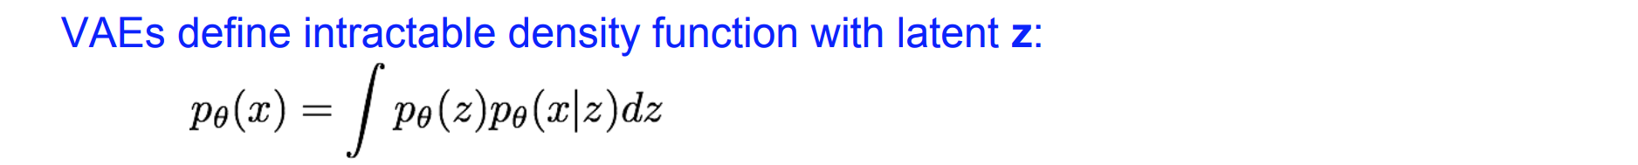
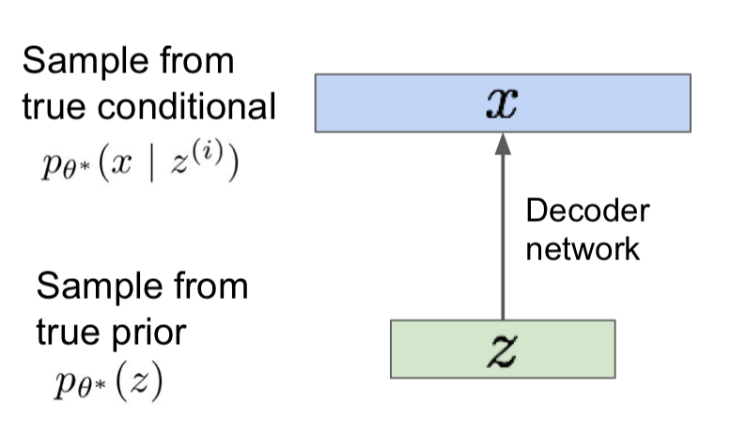
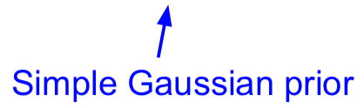
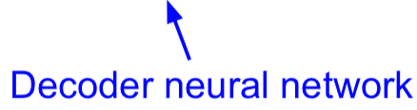
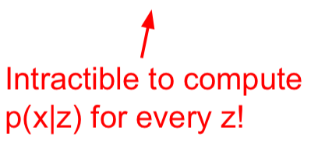
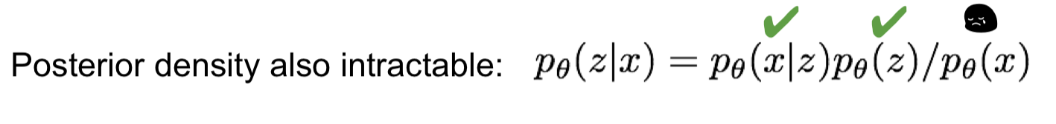
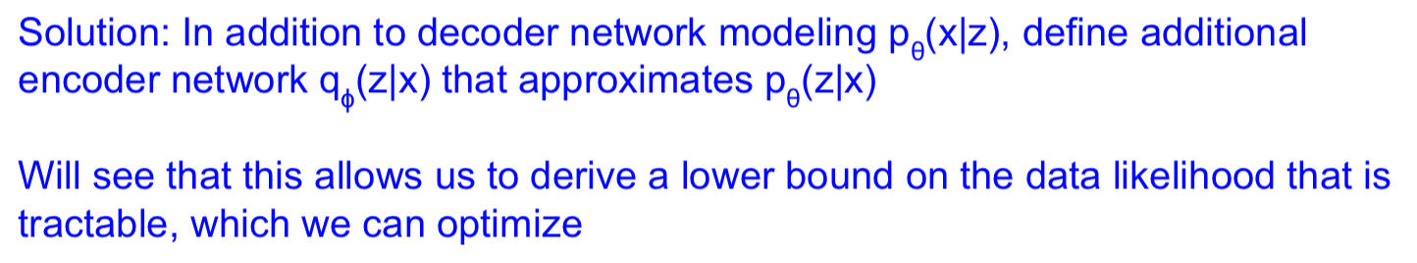

Slide 13
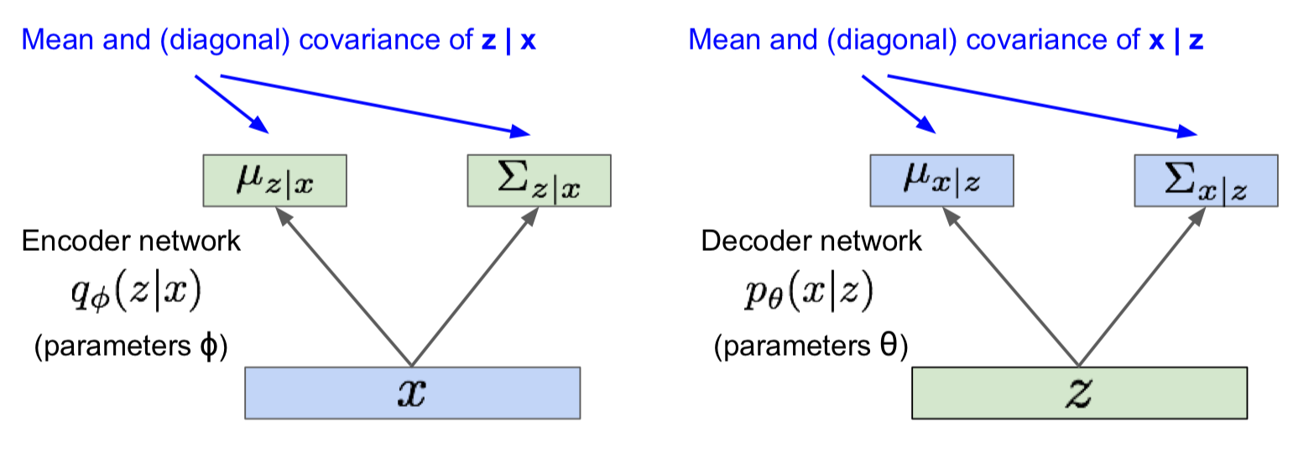
Variational Auto Encoder

Slide 14
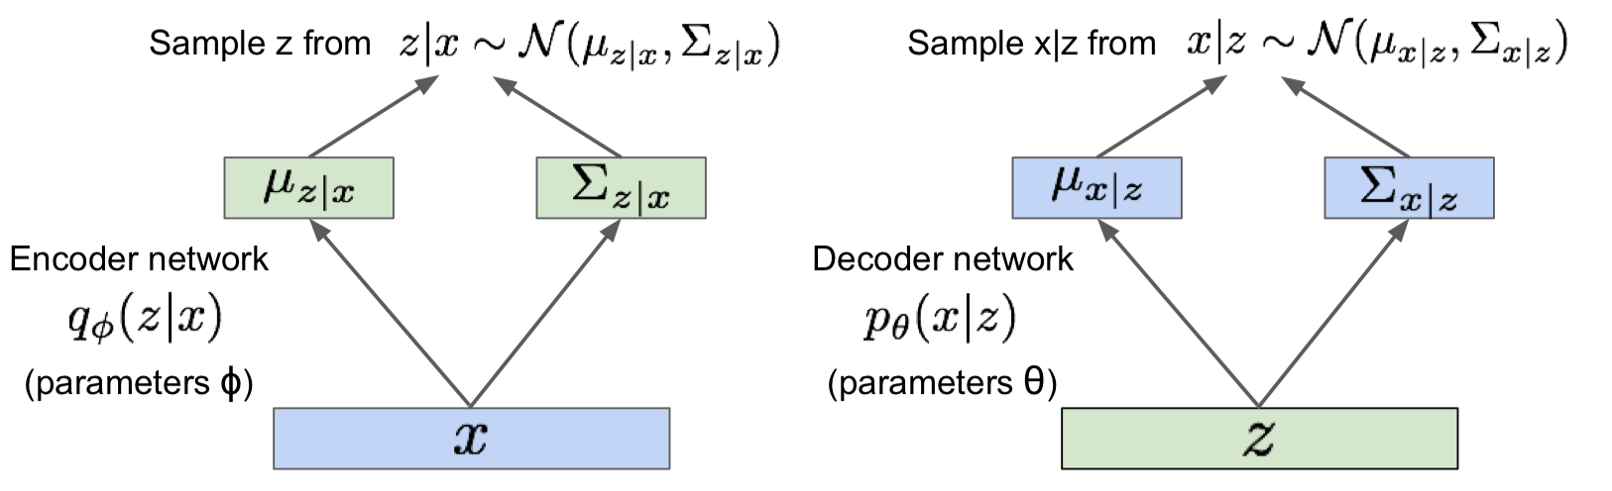
Variational Auto Encoder

Slide 15
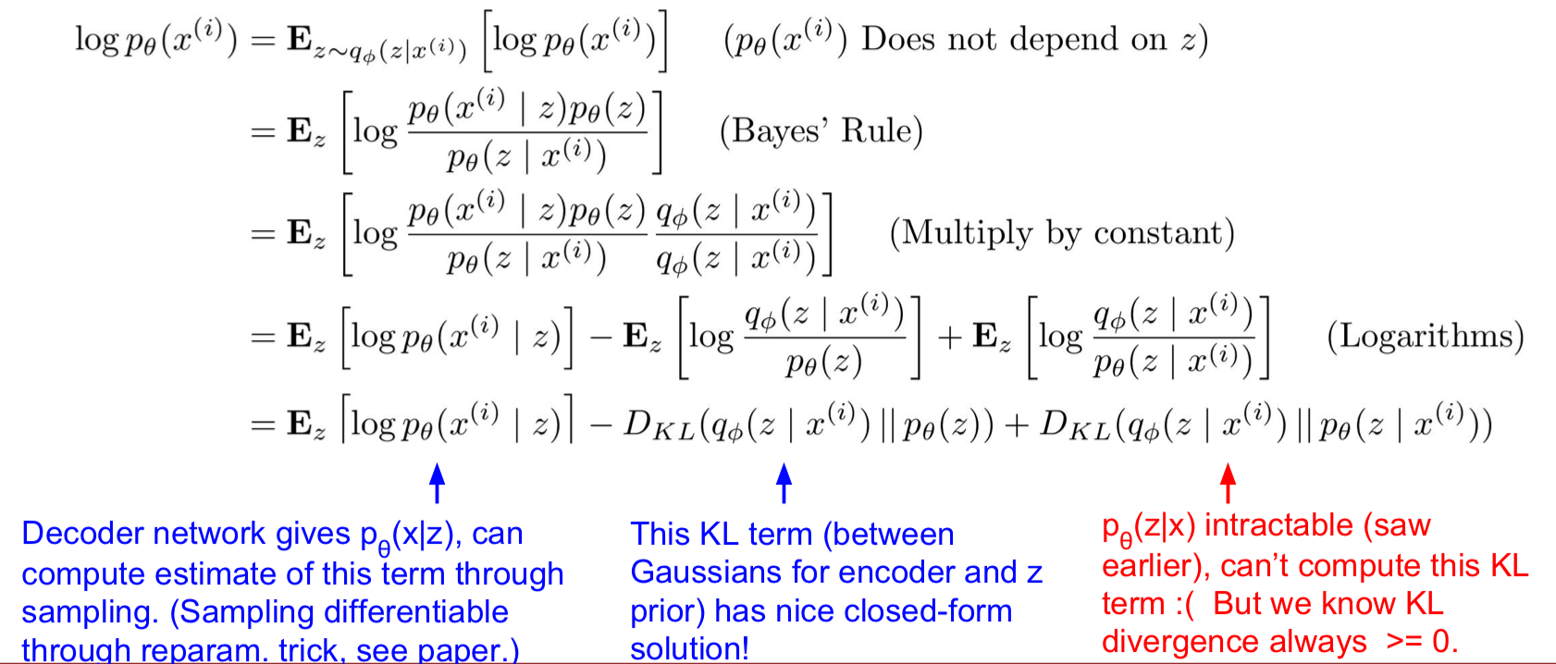
Variational Auto Encoder
Now let's work on (log) data likelihood:

Slide 16
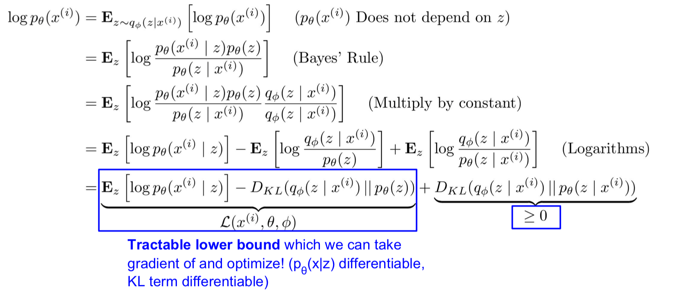
Variational Auto Encoder
Now let's work on (log) data likelihood:

Slide 17
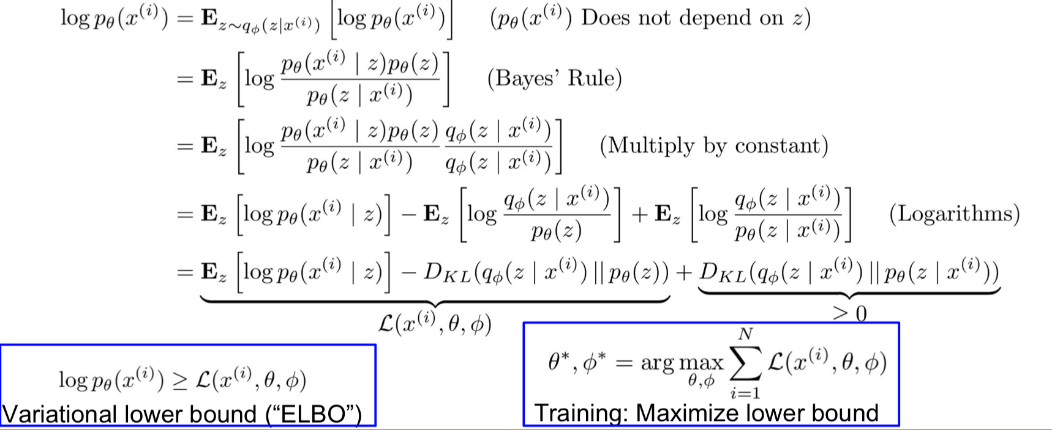
Variational Auto Encoder
Now let's work on (log) data likelihood:

Slide 18
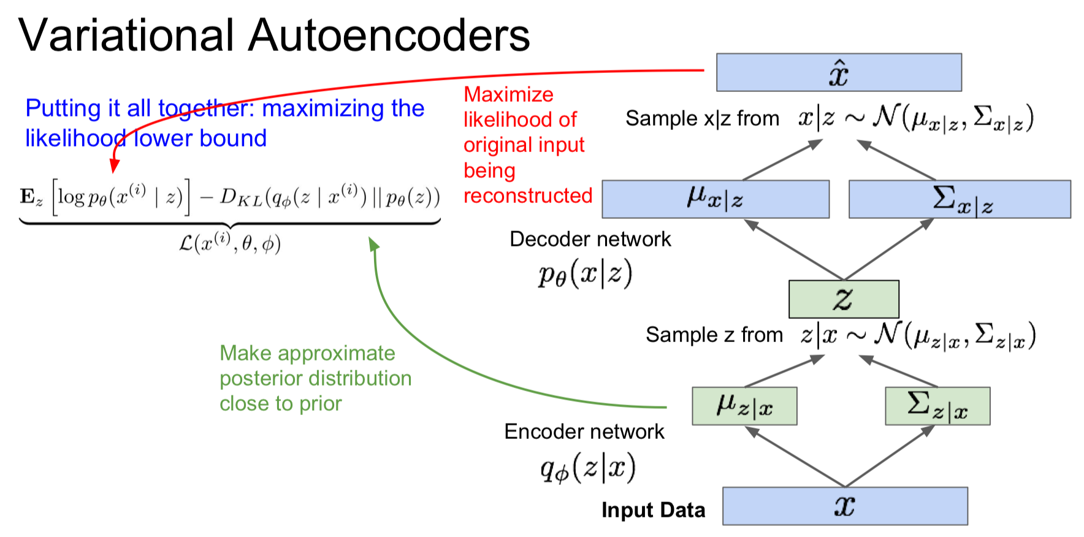

Slide 19
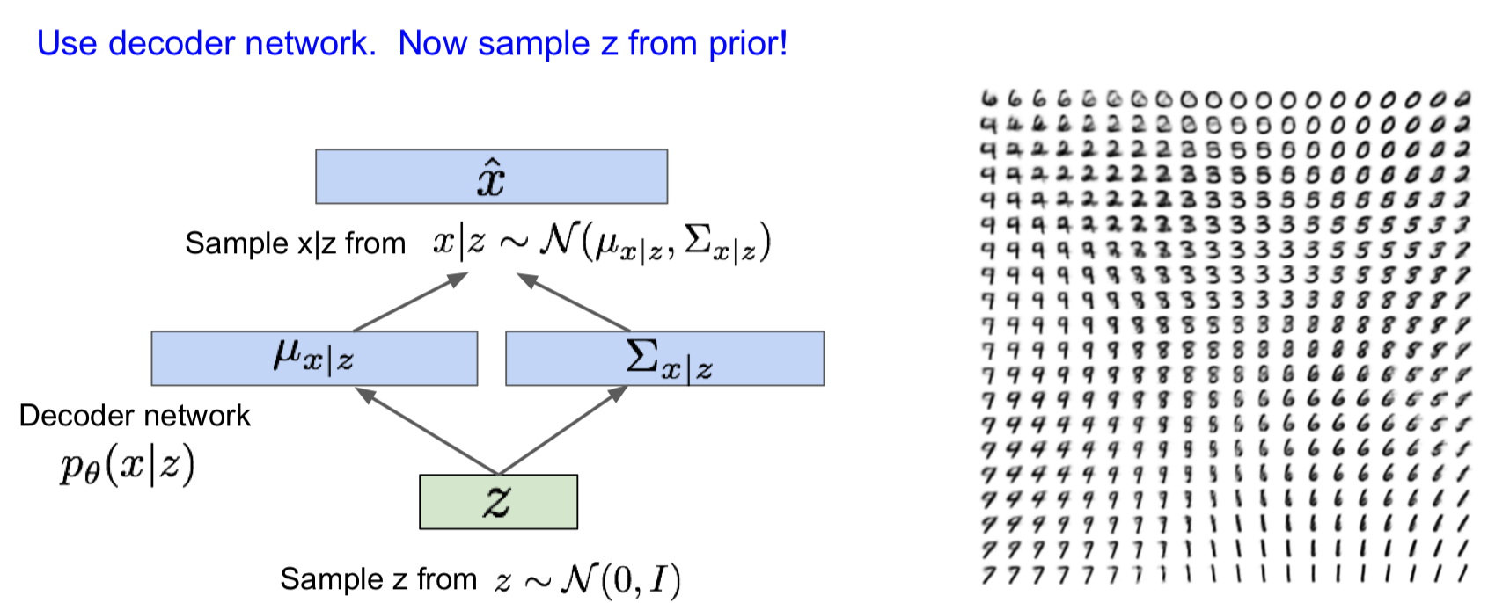
Generating Data !

Slide 20
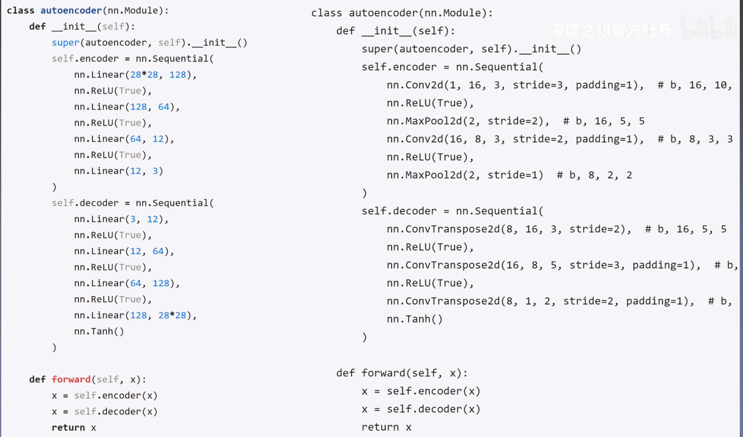

Slide 21
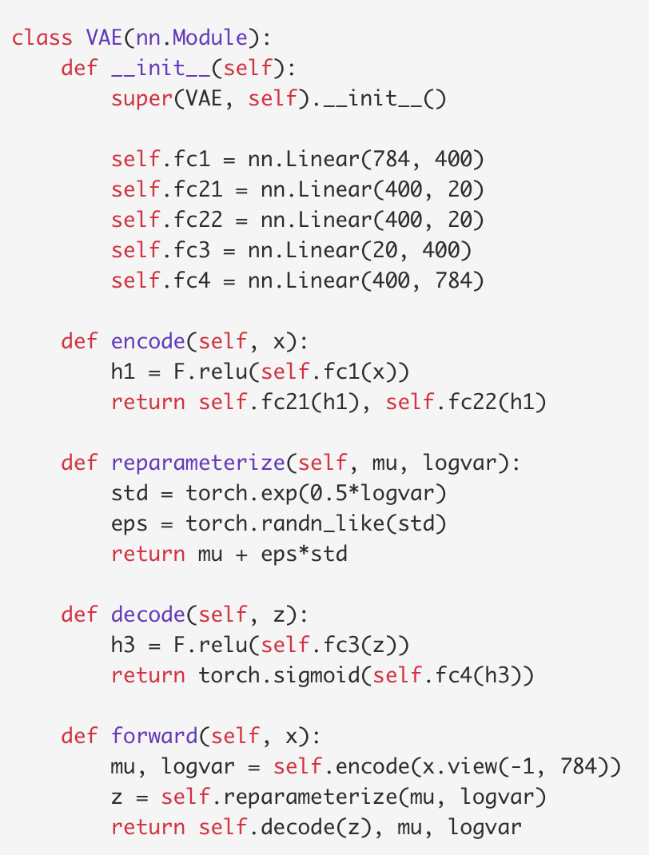

Slide 22
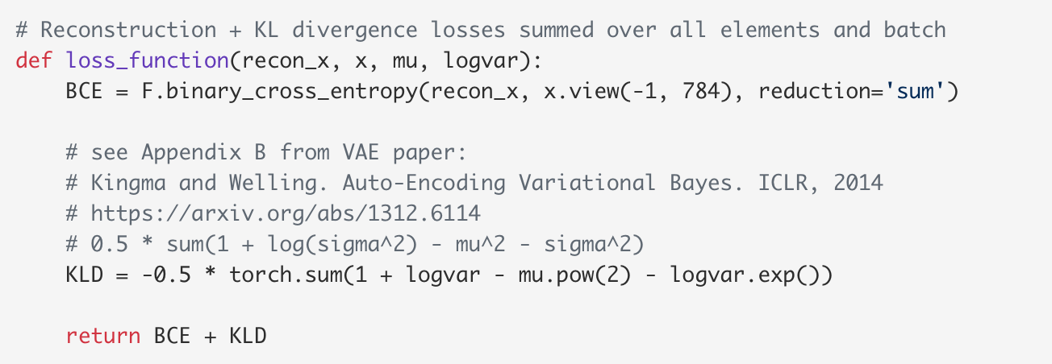
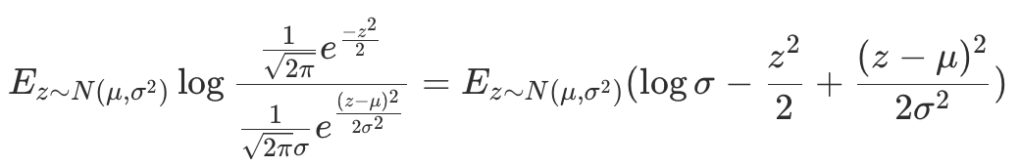
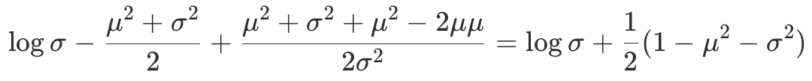

Slide 23
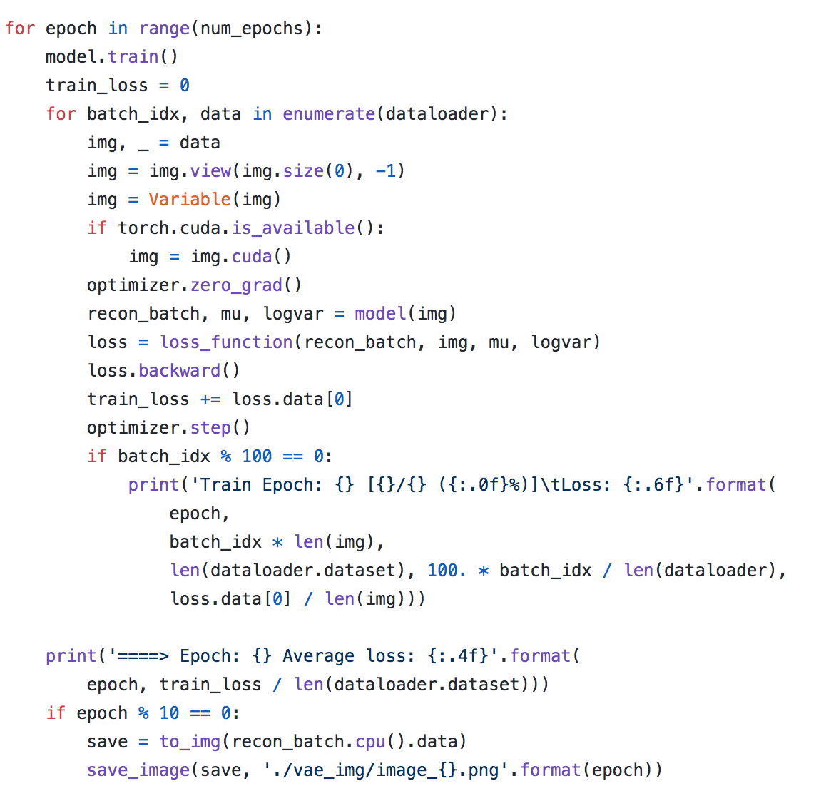

Slide 24
ref
https://github.com/L1aoXingyu/pytorch-beginner/blob/master/08-AutoEncoder/Variational_autoencoder.py
https://github.com/rasbt/stat453-deep-learning-ss21/blob/main/L17/1_VAE_mnist_sigmoid_mse.ipynb
https://github.com/AntixK/PyTorch-VAE
Tutorial on Variational AutoEncoder

Slide 25
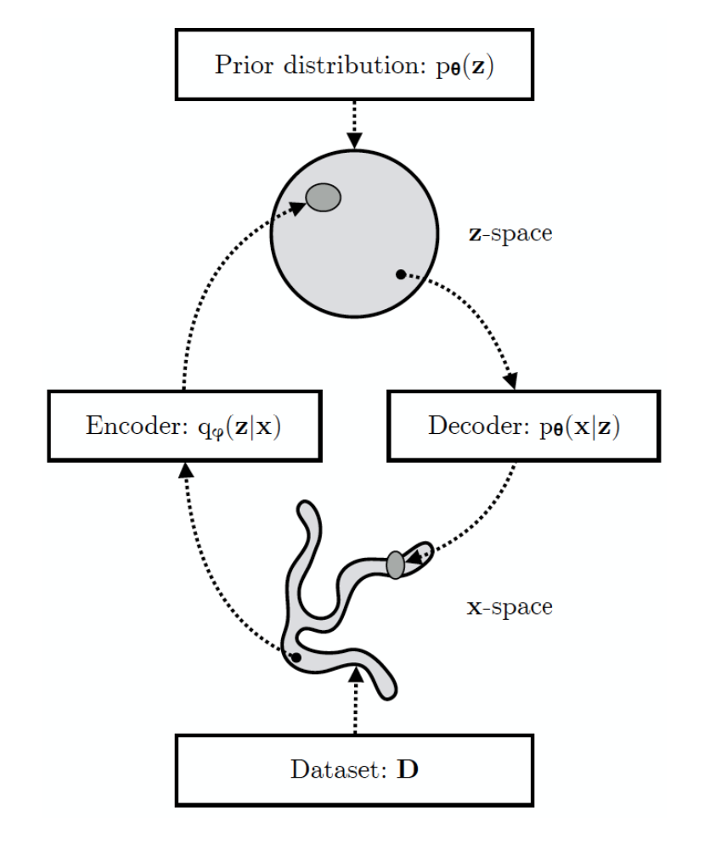
Variational Autoencoders
Probabilistic spin to traditional autoencoders => allows generating data
Defines an intractable density => derive and optimize a (variational) lower bound
Pros:
Principled approach to generative models
Learn "continuou" repreentation in latent pace
Allows inference of q(z|x), can be useful feature representation for other tasks
Cons:
Maximizes lower bound of likelihood: okay, but not as good evaluation as direct estimation
Samples blurrier and lower quality compared to state-of-the-art (GANs)
Active areas of research:
More flexible approximations, e.g. richer approximate posterior instead of diagonal Gaussian
Incorporating structure in latent variables

Slide 26
GAN: Generative Adversarial Network

Slide 27
What if we give up on explicitly modeling density and just want a bility to sample?
GAN: don't work with any explicit density function!
Learn to generate from training distribution through 2-player game.
Problem:
Want to sample from complex, high-dimensional training distribution. No direct way to do this!
Solution:
Sample from a simple distribution, e.g. random noise. Learn transformation to training distribution.

Slide 28
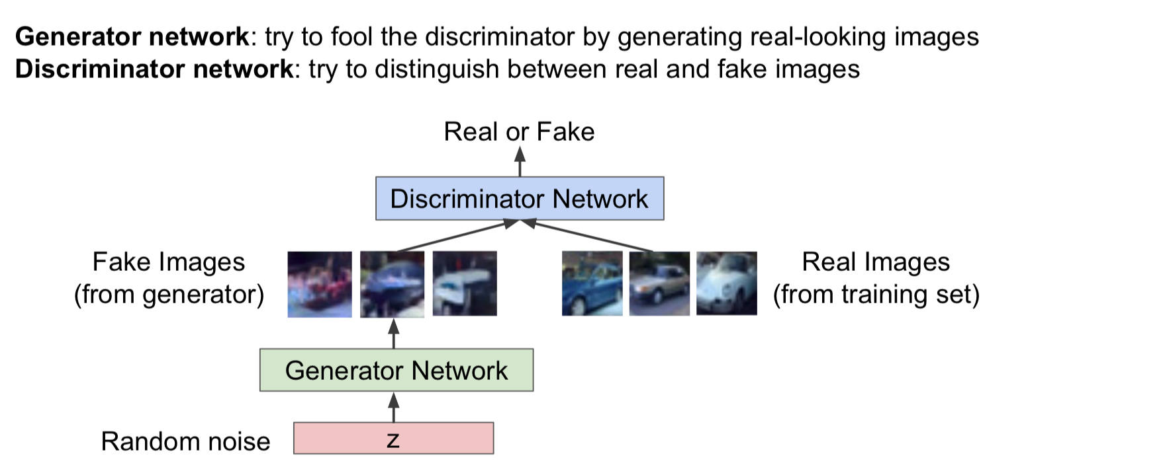
GAN
Ian Goodfellow et al., “Generative Adversarial Nets”, NIPS 2014

Slide 29
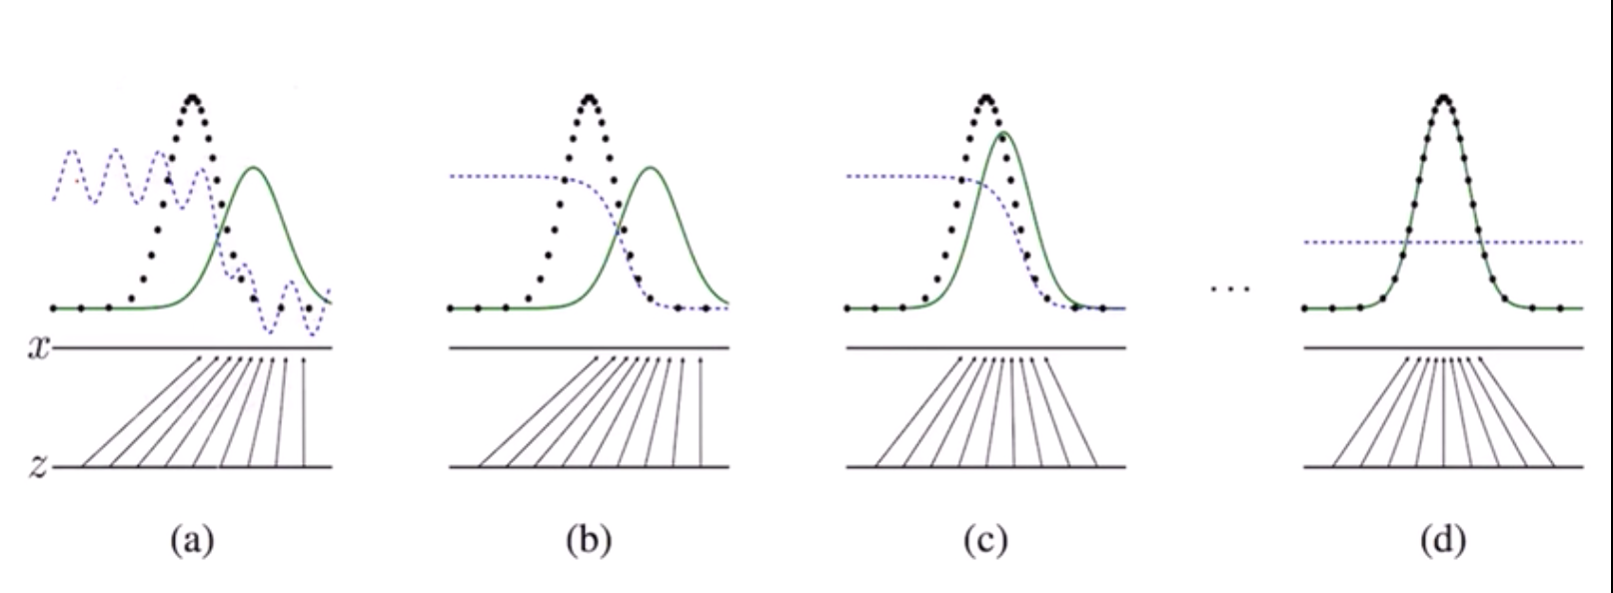
GAN: 2-player game

Slide 30
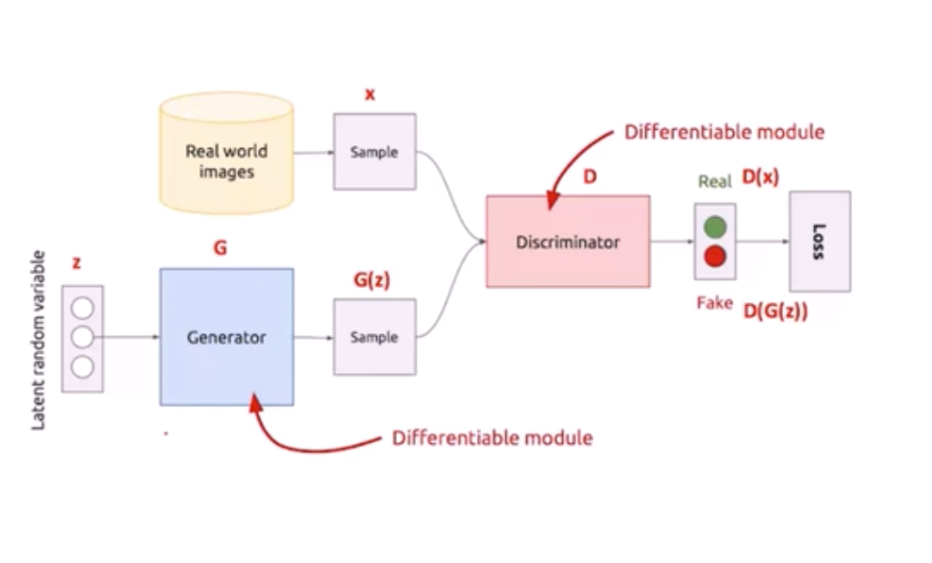
How to define loss function?

Slide 31
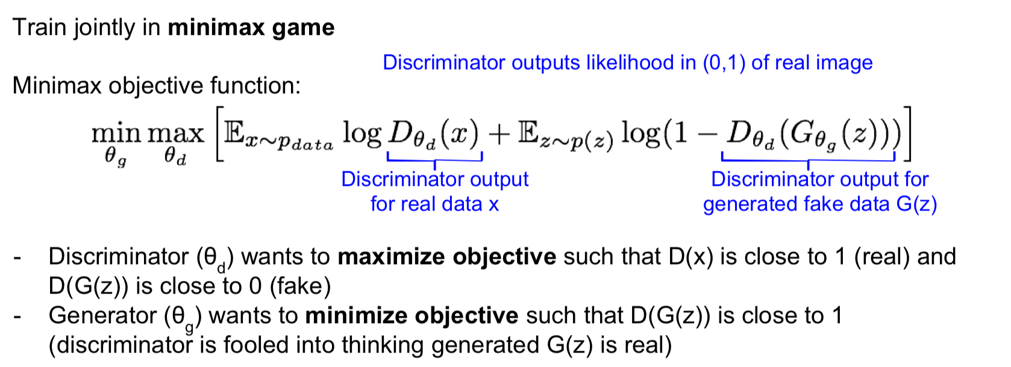
GAN
Ian Goodfellow et al., “Generative Adversarial Nets”, NIPS 2014

Slide 32
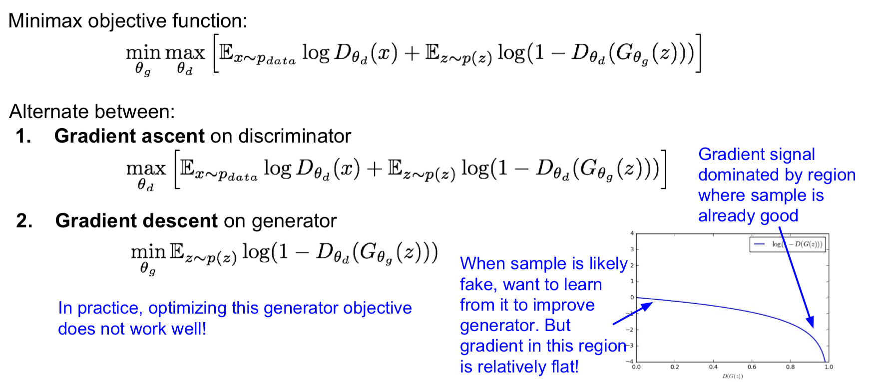
GAN
Ian Goodfellow et al., “Generative Adversarial Nets”, NIPS 2014

Slide 33
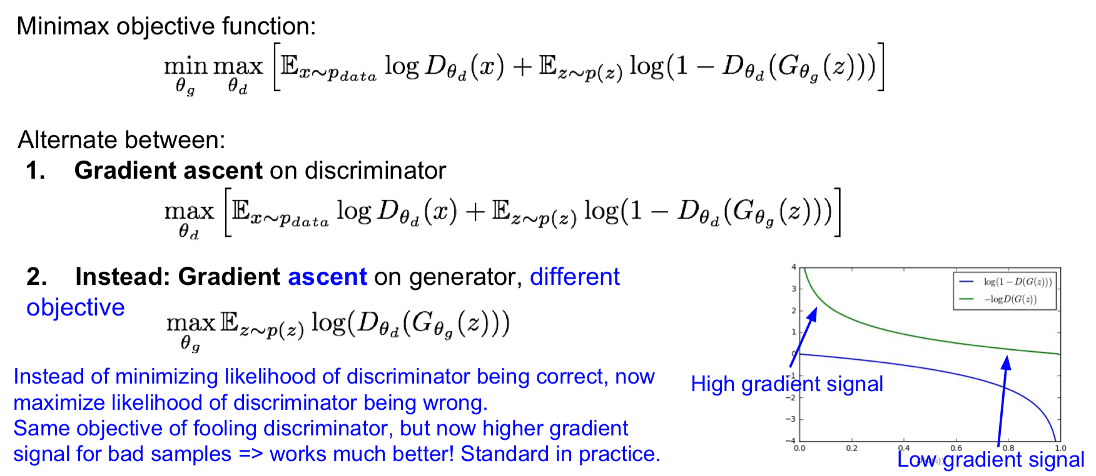
GAN
Ian Goodfellow et al., “Generative Adversarial Nets”, NIPS 2014

Slide 34
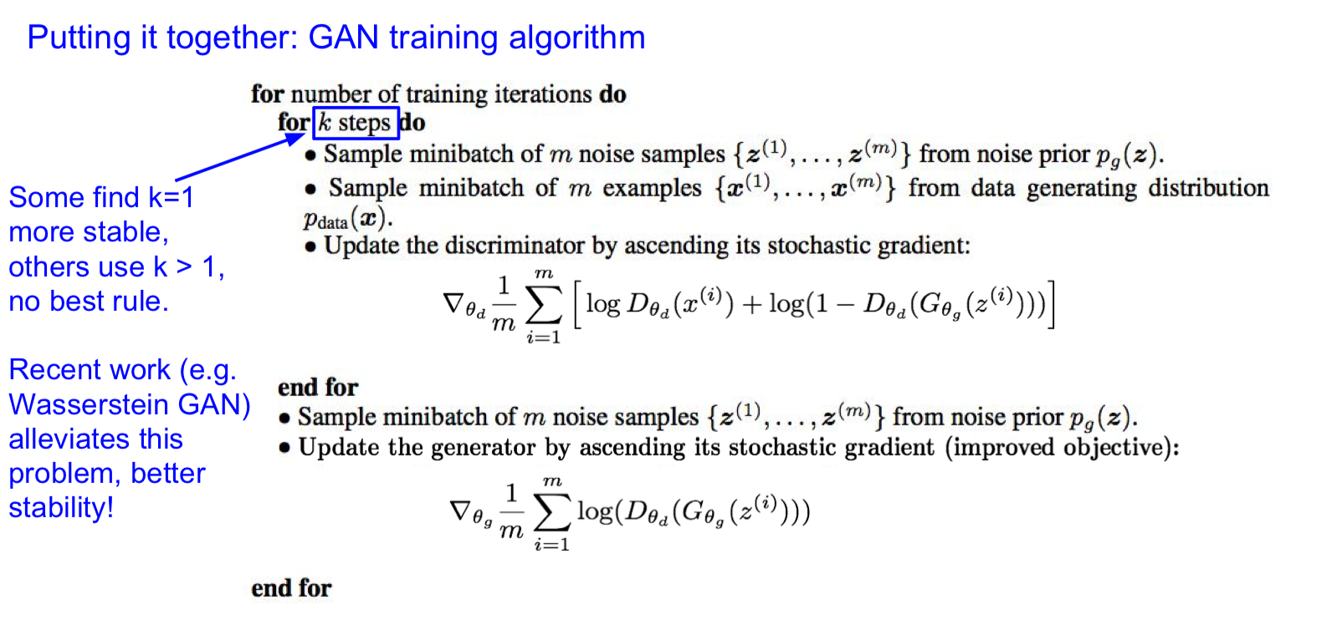
GAN

Slide 35
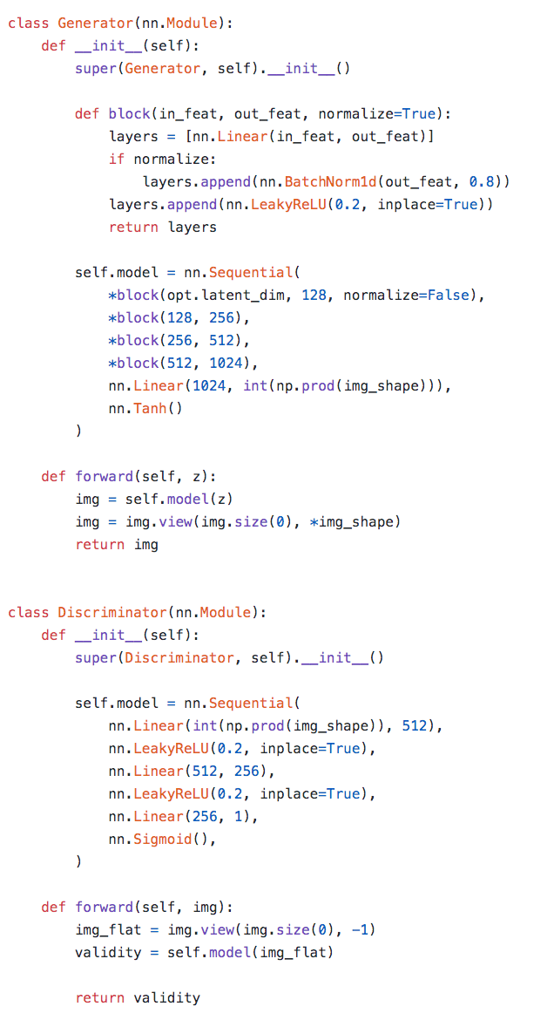
ref： https://github.com/eriklindernoren/PyTorch-GAN

Slide 36
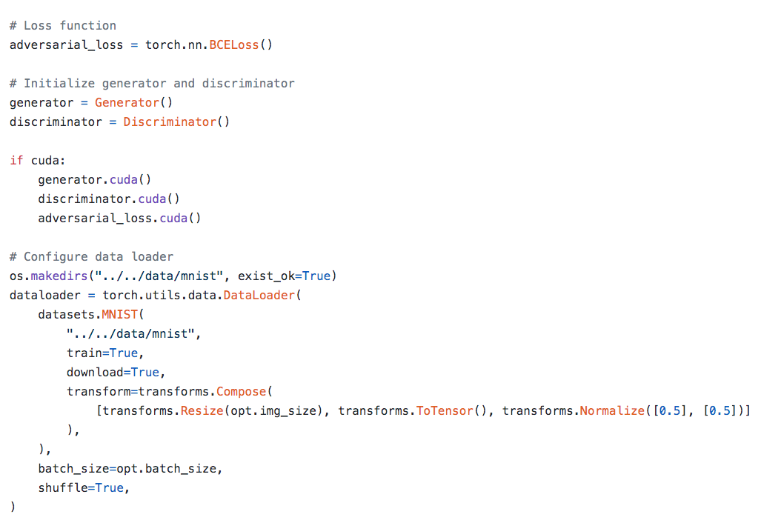

Slide 37
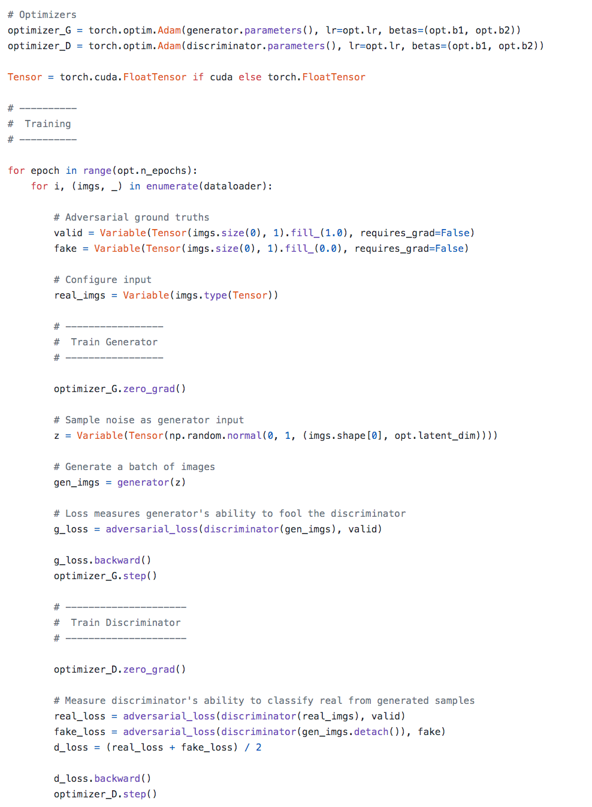

Slide 38
GAN
Don’t work with an explicit density function
Take game-theoretic approach: learn to generate from training distribution through 2-player game
Pros:
- Beautiful, state-of-the-art samples!
Cons:
Trickier / more unstable to train
Can’t solve inference queries such as p(x), p(z|x)Active areas of research:
Better loss functions, more stable training (Wasserstein GAN, LSGAN, many others)
Conditional GANs, GANs for all kinds of applications

Slide 39
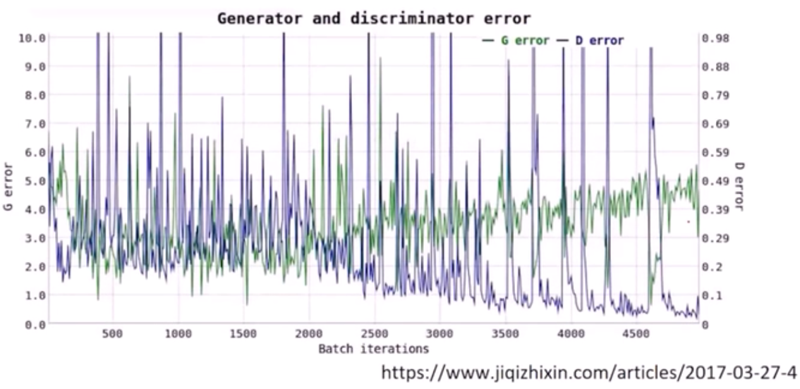
GAN problems:
local optimal.
not convergent when D and G cannot 'grow up better' at the same time.
If D is not good, G can fool D by generating 'same' samples all the time, or samples from G can be too noisy to follow the right distribution.
If D is too good, sometimes G can have vanishing gradient and not be able to converge.

Slide 40
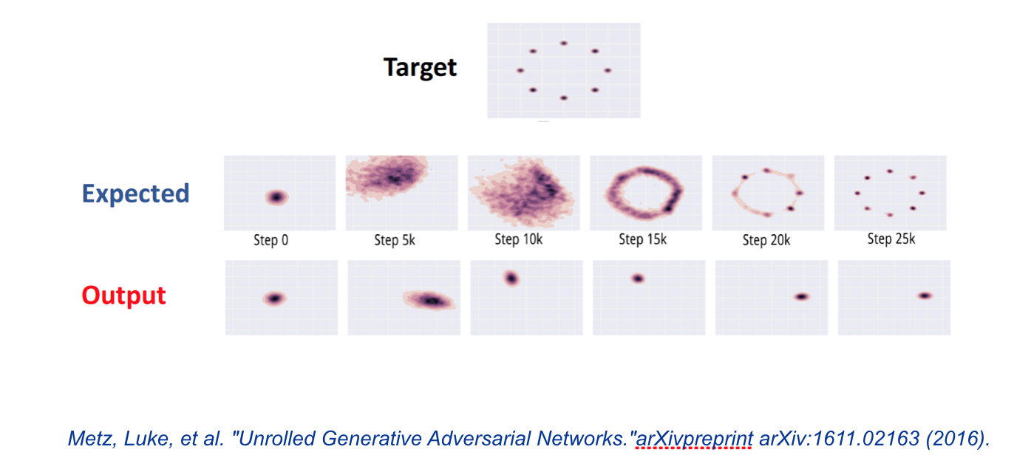

Slide 41



Slide 42

Can we do better on stability, convergence and higher resolution?
DCGAN
CGAN
InfoGAN
WGAN
VAEGAN

Slide 43
Normalizing flow

Slide 44
Normalizing flow
What is normalizing flow?
Normalizing flows provide a general mechanism for defining expressive probability distributions, only requiring the specification of a (usually simple) base distribution and a series of bijective transformations.
References:
G. Papamakarios. Normalizing flows for probabilistic modeling and inference. arXiv:1912.02762v1, 2019.
D. J. Rezende. Variational inference with normalizing flows. arXiv:1505.05770v6, 2016.
David M. Blei. Variational Inference: A Review for Statisticians. arXiv:1601.00670v9, 2018.
L. Dinh. Density estimation using realNVP. arXiv:1605.08803v3, 2017.

Slide 45

Normalizing flow

Slide 46




Normalizing flow
Real NVP
Notes:
How to guarantee the approximation accuracy of transformation T? Partial answer
What are the conditions for transformation T? Machine computing burden
How to train the model?
What are the advantages and disadvantages of RealNVP?

Slide 47



Slide 48



Slide 49
Normalizing flow
What are the alternative transformations?
Planar flow, Radial flow,
NICE, RealNVP,
IAF, MAF
Autoregressive flow,
Neural spline flow, etc.

